Slide 1
Unit 6 Efficient Sorting Algorithms & Analysis

Slide 2
Introduction to O(n logn) Sorting Algorithms
Iterative & Recursive Merge Sort
Quick Sort
Sorting Elements by Frequency
Finding Minimum Length Sorted Sub-array to Sort an Array
Sorting Strings
Case-specific sorting of strings
Count Distinct Pairs with Difference of K

Slide 3
Introduction to O(n logn) Sorting Algorithms
Iterative MergeSort
Recursive MergeSort
QuickSort
https://practice.geeksforgeeks.org/problems/merge-sort/1
https://www.codechef.com/problems/MRGSRT
https://practice.geeksforgeeks.org/problems/quick-sort/1
https://www.hackerrank.com/challenges/quicksort1/problem
https://practice.geeksforgeeks.org/problems/merge-two-sorted-linked-lists/1
https://practice.geeksforgeeks.org/problems/sort-a-linked-list/1

Slide 4
Few more problems
https://practice.geeksforgeeks.org/problems/wave-array/0
https://practice.geeksforgeeks.org/problems/sorting-elements-of-an-array-by-frequency/0
https://practice.geeksforgeeks.org/problems/counting-sort/1

Slide 5
Counting Sort
based on keys between a specific range
works by counting the number of objects having distinct key values
For simplicity, consider the data in the range 0 to 9.
Input data: 1, 4, 1, 2, 7, 5, 2
Count Array - to store the count of each unique object
Output Array - to take the output

Slide 6
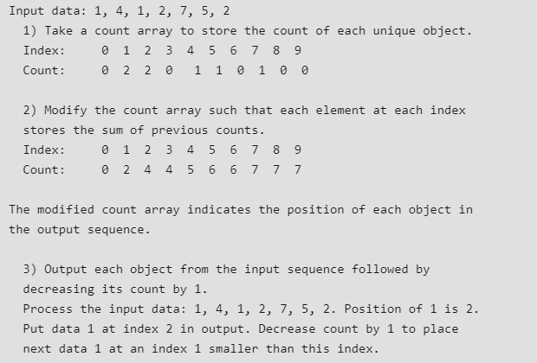

Slide 7
void sort(char arr[])
{
int n = arr.length;
char output[] = new char[n];
int count[] = new int[256];
for (int i = 0; i < 256; ++i)
count[i] = 0;
for (int i = 0; i < n; ++i)
++count[arr[i]];
for (int i = 1; i <= 255; ++i)
count[i] += count[i - 1];
for (int i = n - 1; i >= 0; i--) {
output[count[arr[i]] - 1] = arr[i];
--count[arr[i]];
}
for (int i = 0; i < n; ++i)
arr[i] = output[i];
}

Slide 8
Find the Minimum length Unsorted Subarray, sorting which makes the complete array sorted
https://practice.geeksforgeeks.org/problems/length-unsorted-subarray3022/1
If the input array is [10, 12, 20, 30, 25, 40, 32, 31, 35, 50, 60], your program should be able to find that the subarray lies between the indexes 3 and 8.
Find the candidate unsorted subarray
Scan from left to right and find the first element which is greater than the next element. s is 3 (index of 30)
Scan from right to left and find the first element which is smaller than the next element e is 7 (index of 31)
Check whether sorting the candidate unsorted subarray makes the complete array sorted or not. If not, then include more elements in the subarray.
Find the minimum and maximum values in arr[s..e]. 25 and 40
Find the first element (if there is any) in arr[0..s-1] which is greater than min, change s to index of this element
Find the last element (if there is any) in arr[e+1..n-1] which is smaller than max, change e to index of this element.

Slide 9
https://practice.geeksforgeeks.org/problems/count-distinct-pairs-with-difference-k/0
https://practice.geeksforgeeks.org/problems/count-pairs-with-given-sum5022/1

Slide 10
Start time 4:05 pm
Duration: 1 hr
Marks: 100
Note: Challenge consists of 3 problems
Problem 1 : 25 marks
Problem 2 : 25 marks
Problem 3 : 50 marks
www.hackerrank.com/cse330

Slide 11
Start time 4:05 pm
Duration: 1 hr
Marks: 100
Note: Challenge consists of 3 problems
Problem 1 : 25 marks
Problem 2 : 25 marks
Problem 3 : 50 marks
www.hackerrank.com/cse330-assessment

Slide 12
Maximum number of partitions that can be sorted individually to make sorted
https://leetcode.com/problems/max-chunks-to-make-sorted/
https://practice.geeksforgeeks.org/problems/case-specific-sorting-of-strings4845/1

